Slide 1
Software Testing
Faculty of Computer Science
University of Sunderland

Slide 2
Software Development Processes/Lifecycle
Requirements
Evaluation
tion
Evolu
Validation
Specification
Analysis
Development
Testing
We are here
Design
Development
Also, for SDLC see http://uk.youtube.com/watch?v=OfgfnZZdMlI

Slide 3
Task
Consider how you tested the software you created for the PPWeeks?
If you believe you didn't test it, consider how you could have done.
Take a few minutes to discuss with each other then we’ll feedback.

Slide 4
Can you remember our definitions of software?

Slide 5
Can you remember our definitions of software?
Electronically stored data (as opposed to the HW device it’s stored on).
Sets of instructions that tell a computer what to do.
Programs.
Operating instructions for task based applications.
Programs and associated documentation (requirements, designs, user manuals etc)

Slide 6
This means you can ‘test’ things other than code; you can start testing ages before you even start coding.
And you can ‘test’ during coding – you don’t have to finish development and then turn your attention to testing

Slide 7
Software Development Processes/Lifecycle
Requirements
Evaluation
tion
Evolu
We are also here
(verification)
We are also here
Validation
Specification
Analysis
Development
Testing
We are also here
(verification)
We are here
(verification + validation)
Design
Development
We are also here
(verification)
We are also here
(verification)

Slide 8
Testing, Debugging, Verification & Validation:
Explanations & clarifications!

Slide 9
Testing is not debugging!
Testing is
  Seeing if a given set of inputs causes an acceptable or unacceptable behaviour in a program
Debugging is
  Seeing why a given set of inputs causes an unacceptable behaviour and what must be changed to cause the behaviour to be acceptable

Slide 10
Verification & Validation
Verification
  Are you building the product correctly? (free of faults)
Validation
  Are you building the correct product? (what the specification says/what the customer wants)
Important distinction – because
  a system that works (i.e.is verified) but is not what the users want is no good
  and a system that meets its specification (i.e. is valid/validated) but crashes all the time is no good
  Verification, validation & the iPhone 4

Slide 11
Verification & Validation
Verification
  Developer’s view of the system
  Internal view (code, workings, structure)
  (also beyond code – remember we said software can be associated documentation)
Validation
  User’s view of the system
  External view (appearance, functionality, use)

Slide 12
‘V’ Model
Usability
Design
matches
Requirements
Functional
Validation - build the right thing
Verification – build it the right way (fault-free)
Code
matches Design
Structural

Slide 13
V model
Q. Why is the V more of a triangle than a V?
A. Because the 2 sides MUST link together

Slide 14
‘V’ Model
Requirements
Usability
Design
matches
Requirements
Design
Functional
Validation - build the right thing
Verification – build it the right way (fault-free)
Code
Code
matches Design
Structural

Slide 15
V model
Looks (and can be) very sequential
But – also demonstrates TDD (Test Driven Development)
(these are 2 development approaches or methodologies)

Slide 16
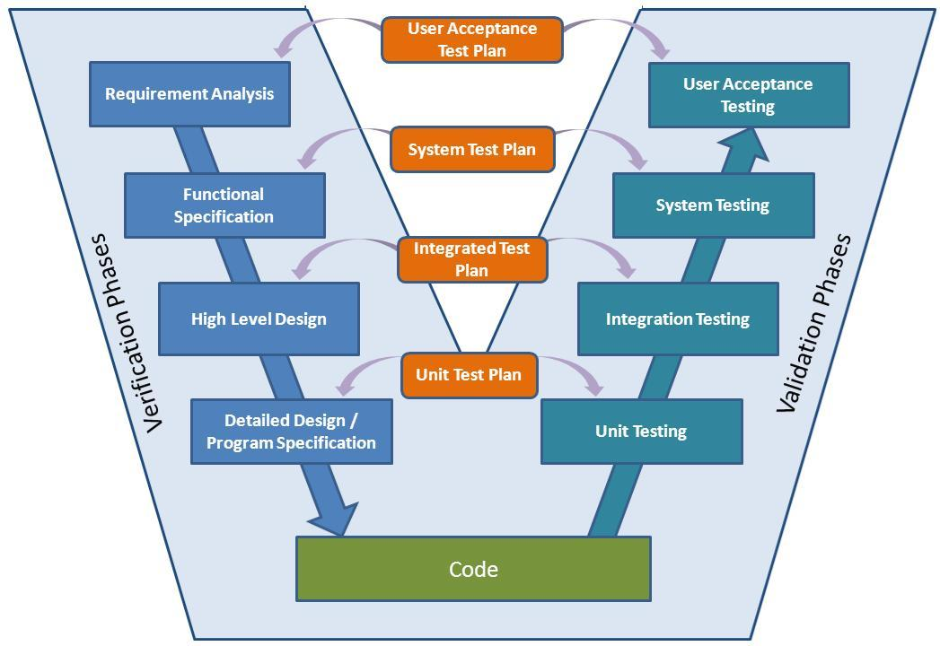

Slide 17
V Model
Although most diagrams show verification down left side and validation up right side, really
verification is at the bottom, pointy end of the triangle and
validation is at the top, wide end!

Slide 18
‘V’ Model
Requirements
validate
Usability
Design
matches
Requirements
Design
Functional
Validation - build the right thing
Verification – build it the right way (fault-free)
Code
Code
matches Design
Structural
verify

Slide 19
User point of view
Functional
No code
validate
Developer point of view
Structural
Examine code
verify

Slide 20
We will look at what is meant by unit testing, integration testing etc. shortly

Slide 21
Can you get away with doing either verification or validation?
No. Why?
Validation depends on the user point of view (requires no knowledge of the system)
Once you’ve verified your requirements are ‘right’, your design is ‘right’, your code is ‘right’, you must then make sure that what you ended up with ‘matches’ the original documentation
Requirements
Usability
Design
matches
Requirements
Design
Functional
Verification – build it the right way (fault-free)
Validation - build the right thing
Code
Code
matches Design
Structural

Slide 22
Now you have the hang of the ‘definitions’
So you can begin to look at what you can actually do to test your software
  What types of test exist?
  How/why do you choose a certain one?

Slide 23
How/why do you choose a certain one?
James Bach on Software Testing
https://www.youtube.com/watch?v=ILkT_HV9DVU
It’s a long talk (1 hour 40 mins)but you can dip in and out
46mins 30seconds – watch the part about testing a dropped calculator

Slide 24
One of the key messages about testing in the James Bach talk is: Check the context!
The context will tell you what/how to test – it’s not just following a rule book
(but if you want to understand the basics read any software engineering text – particularly Douglas Bell, or Pressman, or Sommerville)

Slide 25
Purpose of Testing?
2 different purposes/approaches:
  Test the Structure of the software
    (the code and its structure)
    (includes e.g. unit testing, integration testing)
    (verification)
  Test the Function of the software
    (checks requirements are met without looking at code)
    (validation)

Slide 26
Structural Testing
(White Box/Glass Box testing)
  Developer’s point of view
  See if all parts work correctly
  Looks at the code and its structure
  Test cases examine decision points in the code
  Includes unit testing, integration testing
looks at the component parts individually and validates that each component performs to spec.

Slide 27
Functional testing
(Black Box/ requirements-driven testing)
  User’s point of view (so shouldn’t be all you do!)
  See if each requirement is met
  Doesn’t look at the code
  Examines whether a program accepts the correct inputs and produces correct outputs
  Includes User Acceptance Testing (UAT), Alpha & Beta Testing
Assumes that the tester has no insight into the product under test - it is a "black box".
Focuses on the inputs and outputs of the system without looking into its internals.
verify end-to-end scenarios that your users will engage in.

Slide 28
If you were testing a bicycle not some software
A white box tester would:
look at the tyres, wheels, pedals, frame, and handlebars each independently to see if they met the criterion for those individual parts.
A black box tester would:
ride the bike and report "it feels right".
https://www.atlassian.com/software-testing/?tab=manual-software-testing

Slide 29
Possibly also 3rd type…
Grey Box Testing (kind of see-through)
  User point of view - Grey box testers work in a black box fashion but use underlying information about the system to drive tests.
  Accesses design documentation, and database for example, so tests the user interface definition and functional specification
  So for example you might test data type handling (but then can overlap with white box)

Slide 30
So for the bike analogy
Grey box tester might ride the bike but will deliberately work the gears in a certain way etc…

Slide 31
If you were testing a car…
Black Box?
White Box?

Slide 32
If you were testing a car…
Black Box?
  Petrol in, and drive away, exhaust fumes out etc…
White Box?
  Petrol in, look inside fuel tank, open bonnet, what happens when ignition is turned? Fuel injection….

Slide 33
Let’s come back to PPW’s
How would you have tested
  PPW1
  PPW2
  PPW3
  PPW4

Slide 34
PPW
Verification
Validation

Slide 35
PPW - Verification
Use Software Requirements Specification documents to verify with the client that you are both in agreement what needs to be done to solve the problem
What documents did you create?
Heuristic Inspection
PACT
In this case the PACT would suffice as the documentation
What does the PACT tell you that you think needs testing?

Slide 36
PPW - Verification
Examine code – CSS and HTML in unit testing and integration testing
  Does each individual part work correctly
  Do they integrate correctly e.g. hyperlinks take you to correct next page
P1 was a static website – if there had been more interactivity e.g. a Contact Us page made with a form you would have needed to test more complex code

Slide 37
PPW - Validation
Remember that validation is user view – so is done by both the developer and the users
Not ‘testing code’ here but testing functionality
Your PACT told you the functionality (activities) and the means with which the functionality could be achieved (technologies)
This means moving towards the Non-Functional requirements
  Navigation
  Layout
  Appearance
  Acceptability to user – does it do what the SRS (requirements spec) said it should do? e.g. a search bar allows them to perform a search.

Slide 38
How could you use a PACT in verification & validation?
Think of the 4 sections – P, A, C, and T
Think which could be used in verification and which in validation – and how?

Slide 39
Using a PACT in verification and validation
PACT forms the basis of your structural and your user acceptance test(UAT)plans
Verify requirements with client (check every section P,A,C & T is correct)
Ensure what you said in P = the people you actually do the UAT with
Ensure what you said in C = the context of use you use in your UATs
Verify (structurally) the Activities
Validate (functionally) the Activities via the Technologies

Slide 40
In more detail:
Ensure what you said in P = the people you actually do the UAT with
For example – if you are designing a product to be used by 25 year old men you can’t test it with 60 year old women – it’s not the right audience!

Slide 41
In more detail:
Ensure what you said in C = the context of use you use in your UATs
For example – if you are designing a product to be used on a mobile platform, on the go, you wouldn’t test it on a desktop, in an office – it’s not the right context of use!

Slide 42
In more detail:
Verify (structurally) the Activities
Means that you (the developer/tester) must check the code works for a given function/activity – e.g. the code behind a search bar
Validate (functionally) the Activities via the Technologies
Means you must design a UAT test that you know will require the user to use a particular technology e.g. you must require them to search for something which in turn means you’ll require them to use the search bar to carry out that function/activity

Slide 43
PPW – How you could have done verification
Use Software Requirements Specification documents to verify with the client that you are both in agreement what needs to be done to solve the problem
What documents did you create?

Slide 44
Homework task
Think about how you would use the PACT to do both verification and validation?
Write this up in a document (including the answers for the PACT PPW) and upload to your learning activities

